Slide 1
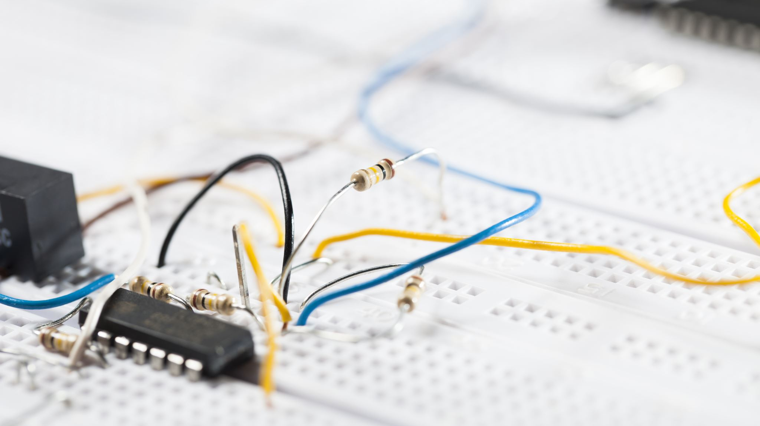
Super Node Section 3.3
Md. Shafqat Talukder Rakin
Lecturer, Department of CSE,
United International University
Email id : shafqat@cse.uiu.ac.bd

Slide 2
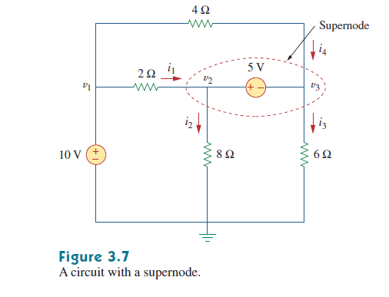
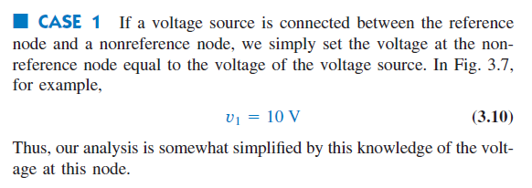
Node Analysis with Voltage sources

Slide 3



Node Analysis with Voltage sources (Continued)

Slide 4
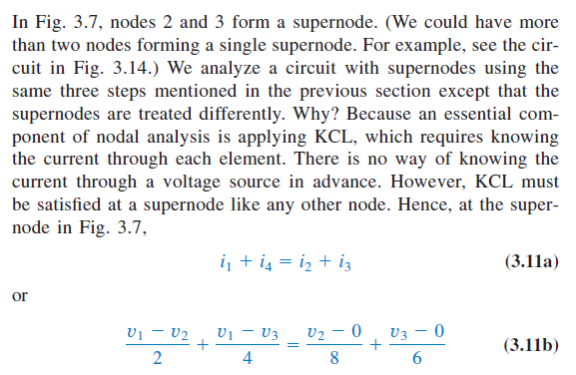
Node Analysis with Voltage sources (Continued)

Slide 5
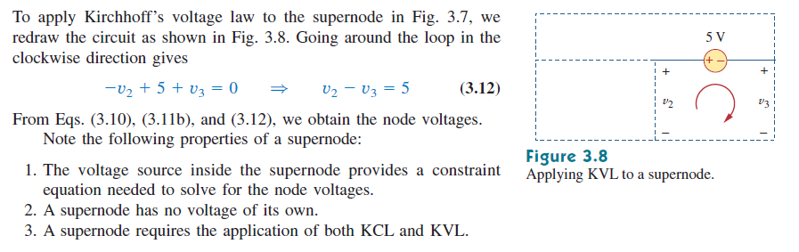
Node Analysis with Voltage sources (Continued)

Slide 6
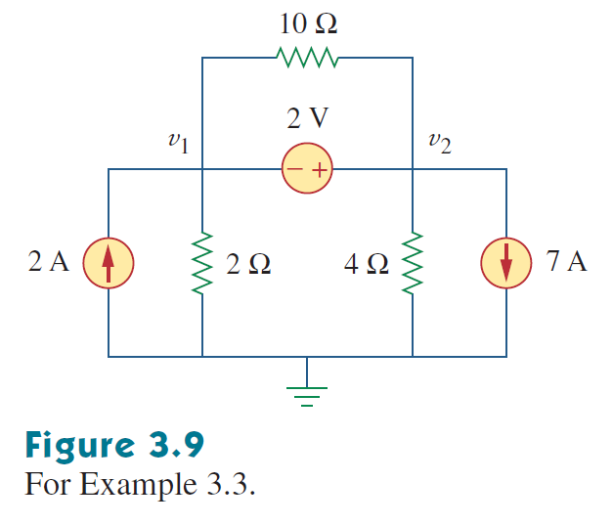
Math Problem Practice:
Determine the voltages at the nodes.
Reference: Sadiku_Example_3.3

Slide 7
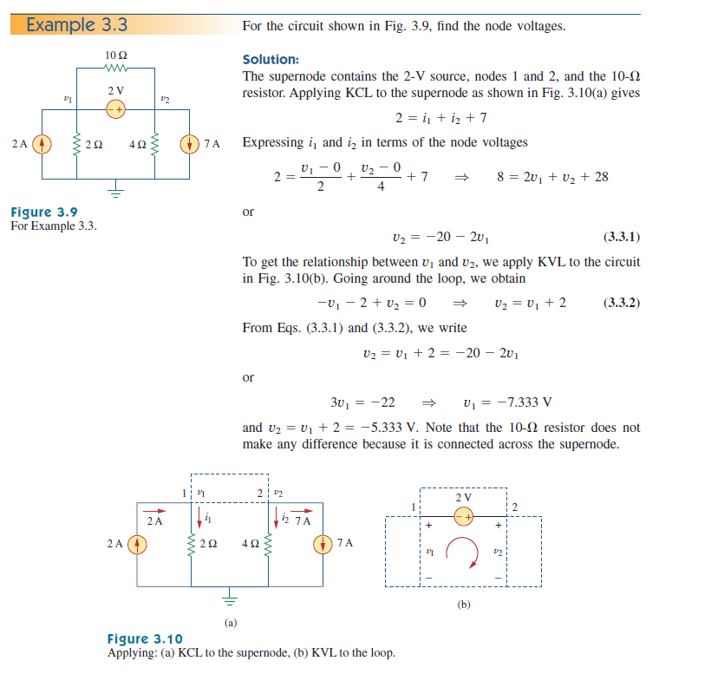
Math Problem Practice:
Reference: Sadiku_Example_3.3

Slide 8
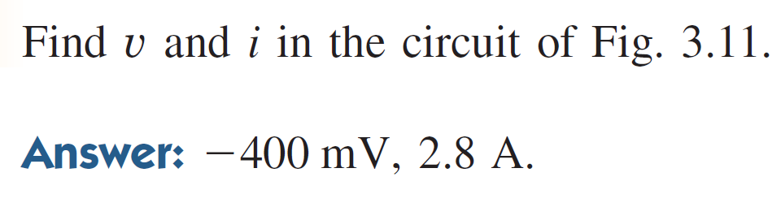
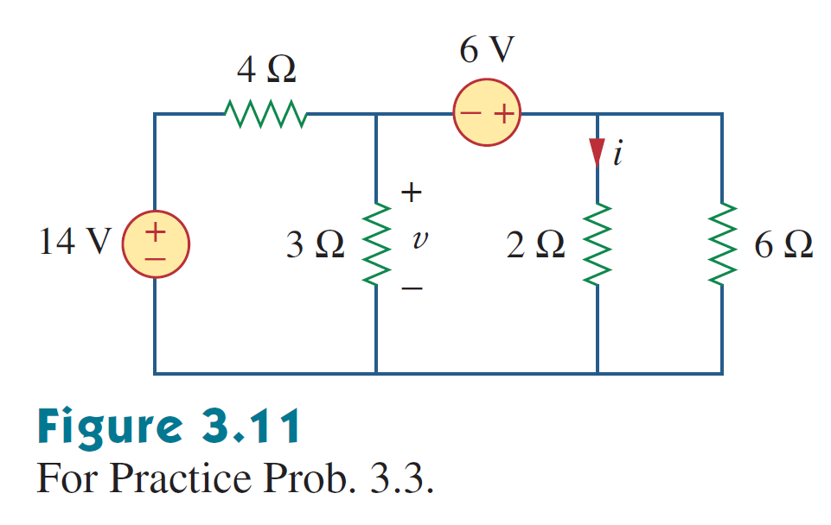
Math Problem Practice:
Reference: Sadiku_Practice_Problem_3.3

Slide 9
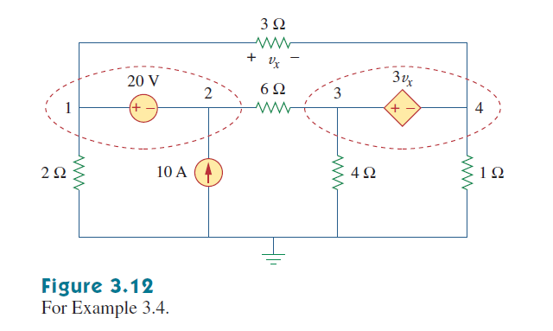
Math Problem Practice:
Determine the voltages at the nodes.
Reference: Sadiku_Example_3.4

Slide 10
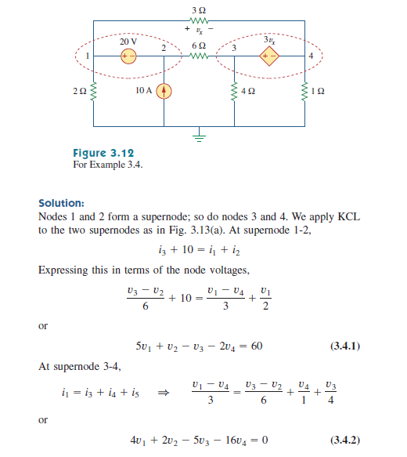
Math Problem Practice:
Reference: Sadiku_Exercise_3.4

Slide 11
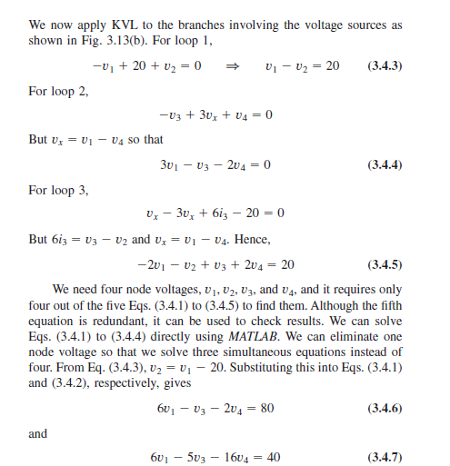
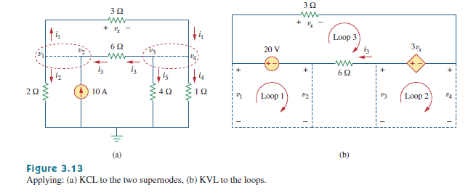
Math Problem Practice:
Reference: Sadiku_Example_3.4

Slide 12
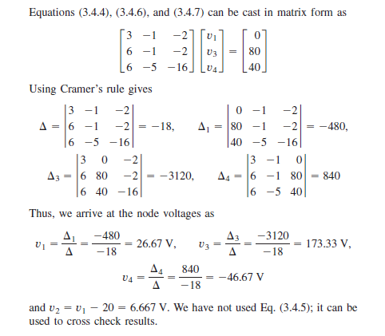
Math Problem Practice:
Reference: Sadiku_Example_3.4

Slide 13
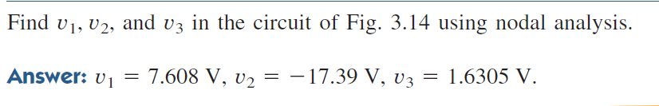
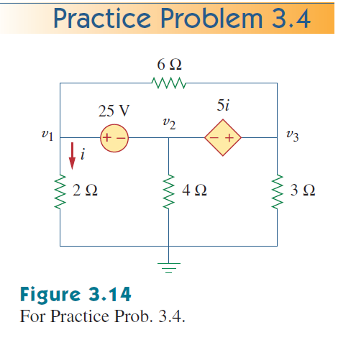
Math Problem Practice:
Reference: Sadiku_Practice_Problem_3.4

Slide 14
Thank You for patient Hearing

